Slide 1
SNMP WALK-THROUGH
CW2 DELISI

Slide 2
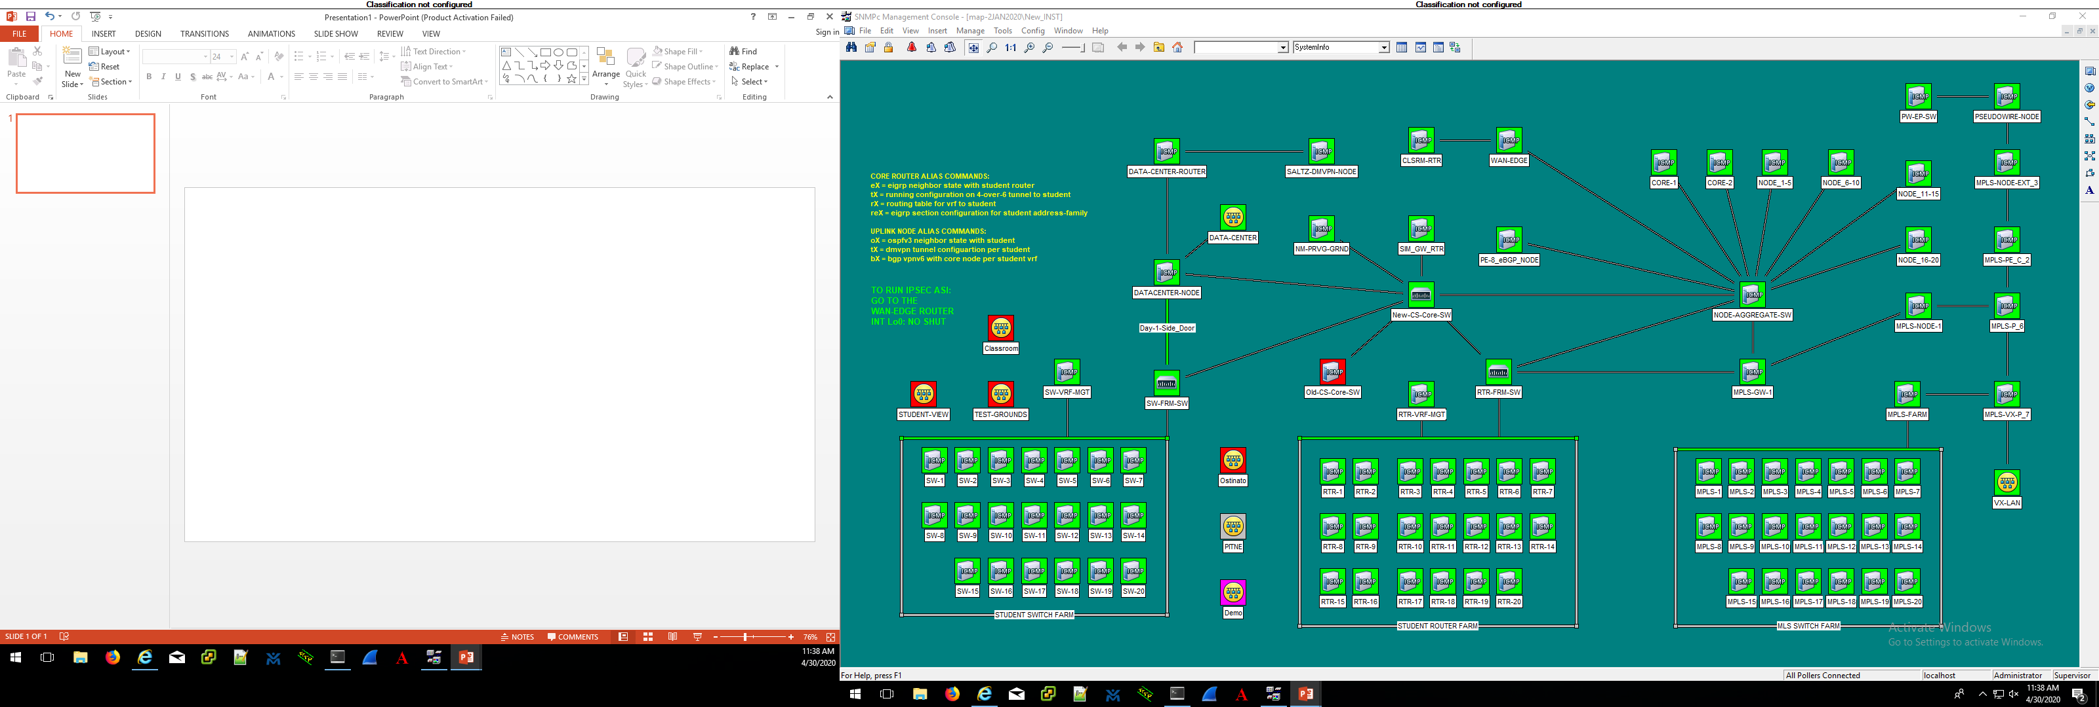

Slide 3
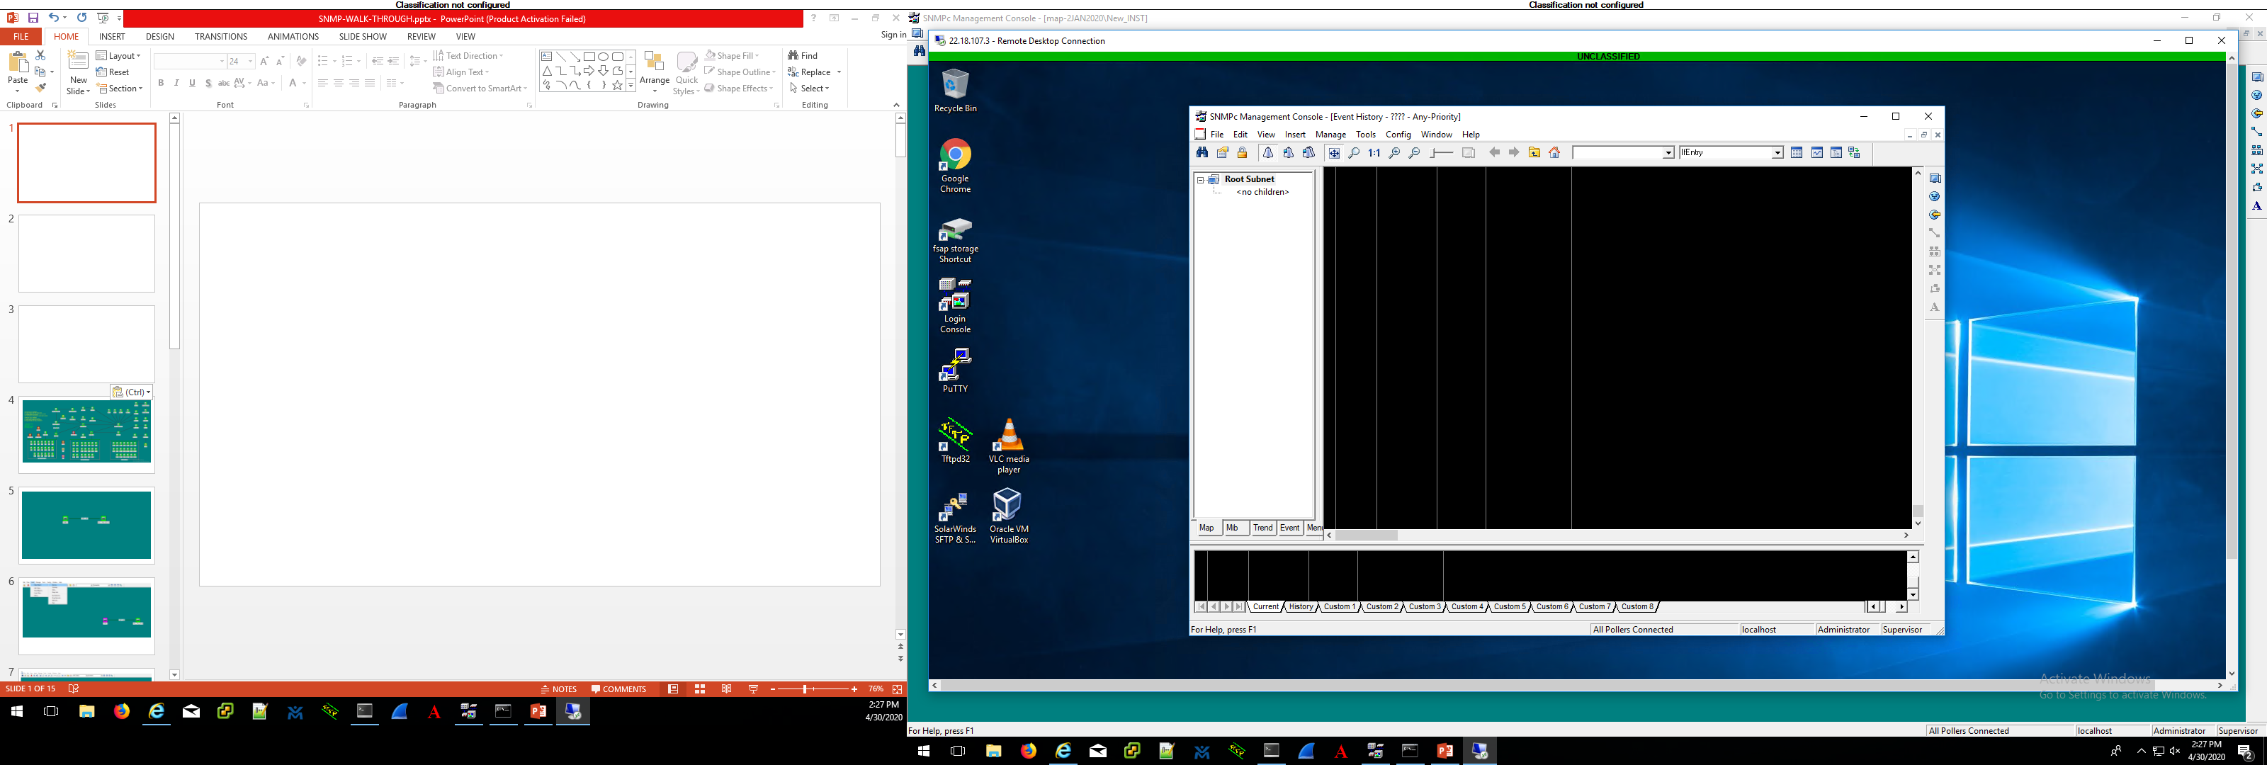
When you double-click on the SNMP Login Console
Desktop icon you will prompted to login. The
Credentials listed below will already be populated
(no password), just click “OK”
Server IP Address: localhost
Username: Administrator
Password: **leave blank**
Click on the “house” icon to
get to your SNMP map home

Slide 4
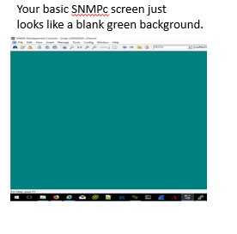

Slide 5

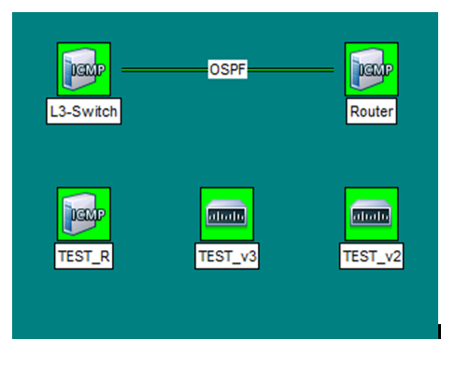

A router, switch or other network element that has an SNMP cli configuration is the “agent”. The SNMP configuration tells the network element which “managers” it can provide information to and what kind of information.
A workstation running SMNPc software is the “manager”. The SNMP icons on the screen provide visual representations of information the manager is getting from the agent.

Slide 6
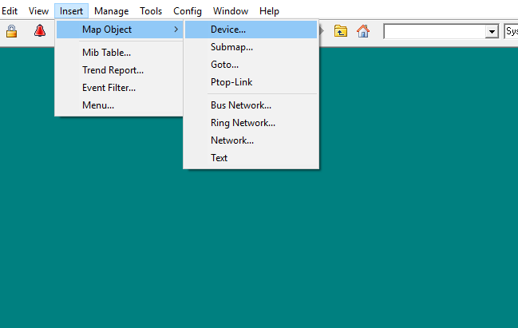

Slide 7
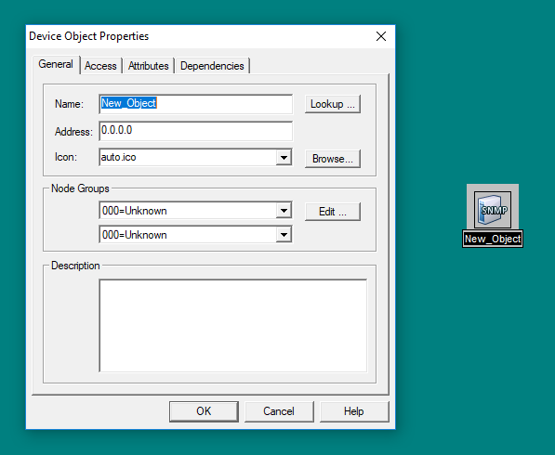

Slide 8
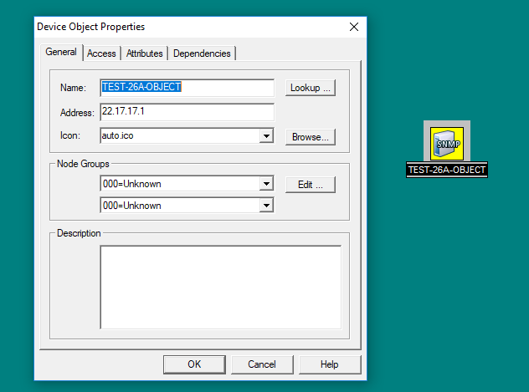

Slide 9
MANAGER
AGENT
“26A TEST OBJECT”
22.17.17.30 /27
22.17.17.1 /27
For ICMP reachability to show green on the manager’s SNMP map, the “agent” does not need any SNMP configuration at all. It only has to have a return path for the pings sourced by the manager.
If an icon on the SNMP manager is set to poll for ICMP only, it shows a green or “OK” status as long as it can ping the applicable device. The device is identified in the icon by its IP address.

Slide 10
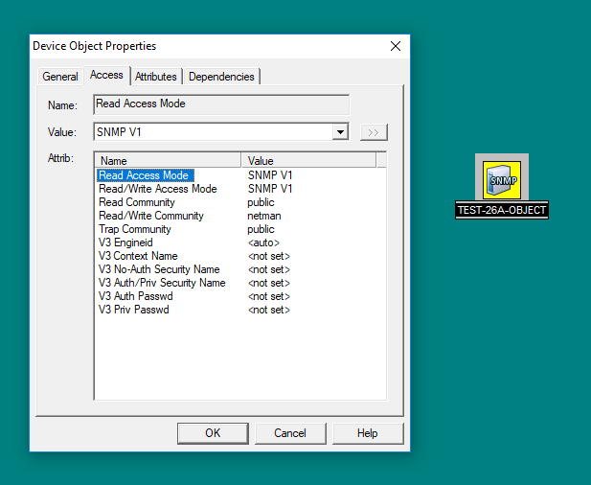

Slide 11
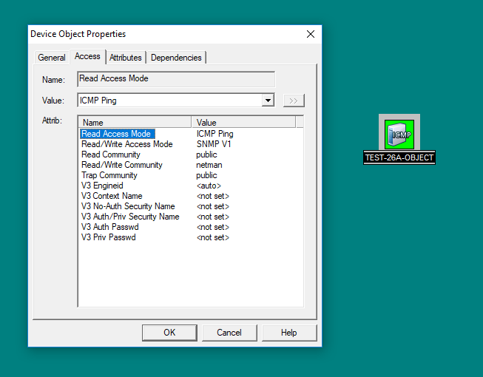

Slide 12
MANAGER
SNMPv2
AGENT
“26A TEST OBJECT”
22.17.17.30 /27
22.17.17.1 /27
If an icon on the SNMP manager is set to poll for SNMPv2, it needs basic reachability along with credentials listed on the access tab of the icon. The SNMPv2 credentials are called community strings and they are basically just a password that tells the agent whether it should give the manager information (READ ONLY) or information and the ability to make configuration changes (READ WRITE) through SNMP.

Slide 13
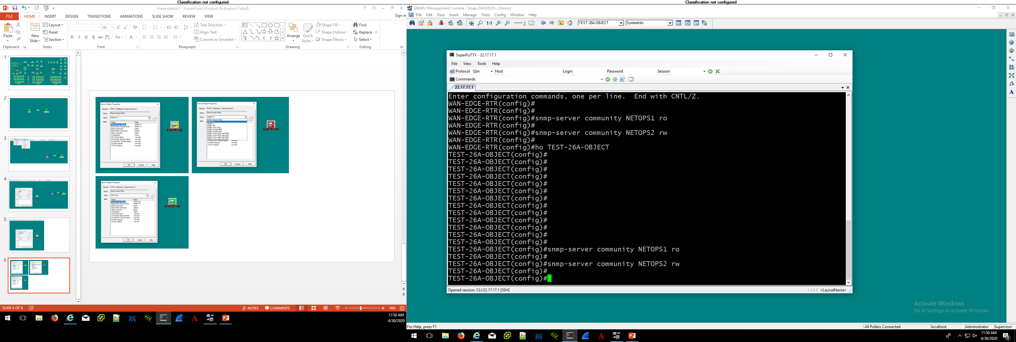
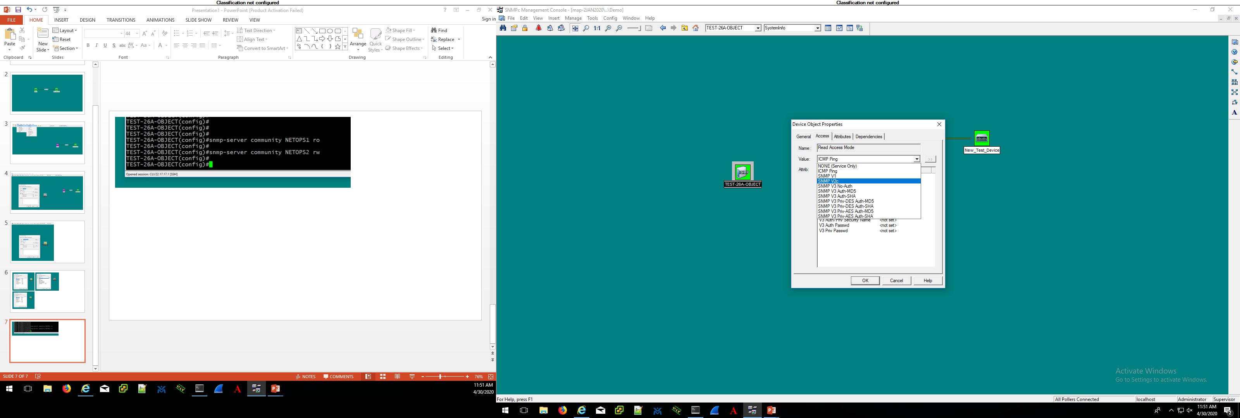
Changing the READ or READ/WRITE access mode by using the drop-down menu modifies the value that the icon is checking for, ie: ICMP vs SNMP.

Slide 14
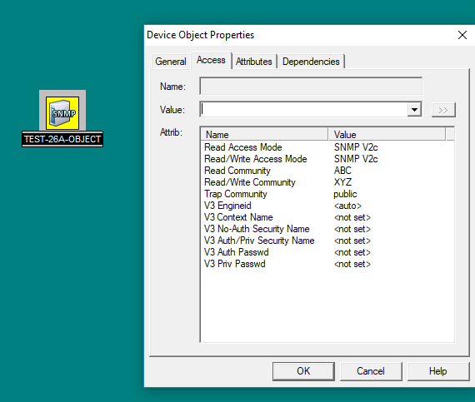
For SNMPv2 to work, the credentials specified in the manager’s SNMP icon must match what is in the agent’s running config.
BAD READ AND WRITE
CREDENTIALS, SO THE ICON
TURNS YELLOW.
THE ICON SHOWS “SNMP”
NOW INSTEAD OF “ICMP”

Slide 15
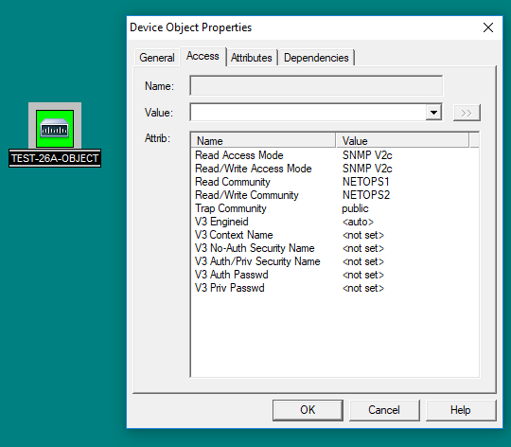
CREDENTIALS MODIFIED TO
MATCH THE CONFIGURATION ON
THE ROUTER TURNS THE ICON GREEN.
THE ICON SHOWS A “CISCO ROUTER”
ICON BECAUSE IT IS ACTUALLY GETTING
DEVICE INFORMATION FROM THE
AGENT.

Slide 16
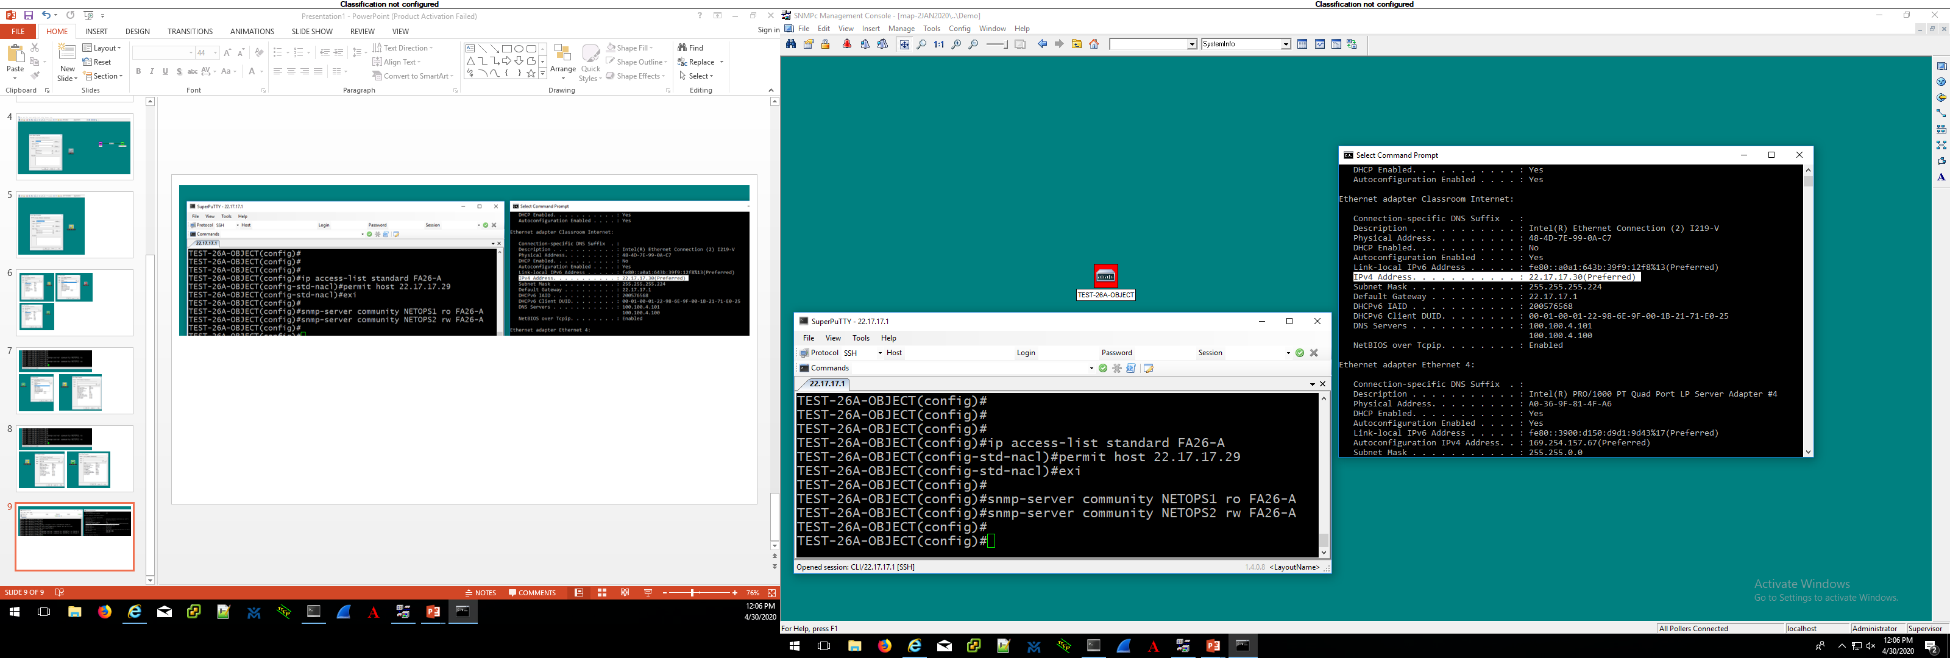
MANAGER
22.17.17.30 /27

Slide 17
If an access-list is added to the SNMPv2 configuration, the credentials must match and the manager trying to obtain information or makes changes via SNMP must be permitted by the access-list.

Slide 18
MANAGER
UDP 161
THE PASSWORD IS NETOPS1 SEND ME THE A RESPONSE TO MY POLL FOR INFORMATION
AGENT
“TEST 26-A OBJECT”
THAT IS THE PASSWORD I’M TRACKING BUT YOU DONT MATCH THE ACL, SO I WILL NOT SEND THE INFORMATION
22.17.17.30
“GET” AND “RESPONSE”
TRAFFIC IS TYPICALLY SENT
BETWEEN DEVICES ON UDP
PORT 161
22.17.17.1
RESPONSE NOT SENT
SNMPv2 agent running configuration:
snmp-server community NETOPS1 ro FA-26A
snmp-server community NETOPS2 rw FA-26A
Ip access-list standard FA-26A
Permit host 22.17.17.29

Slide 19
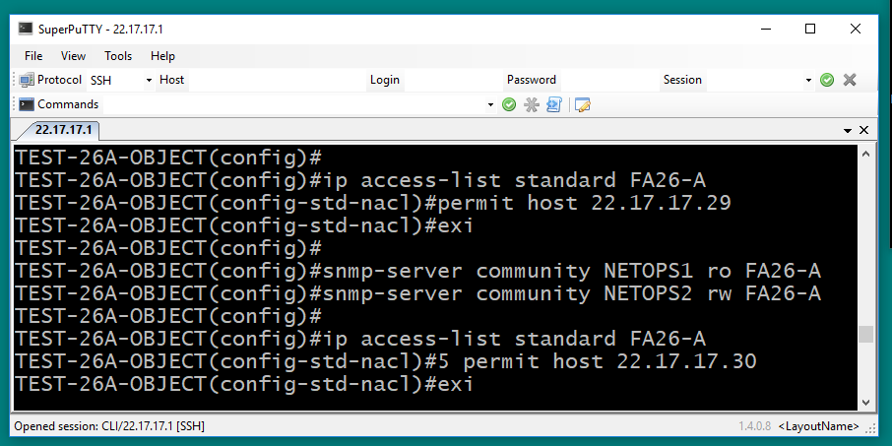

Slide 20
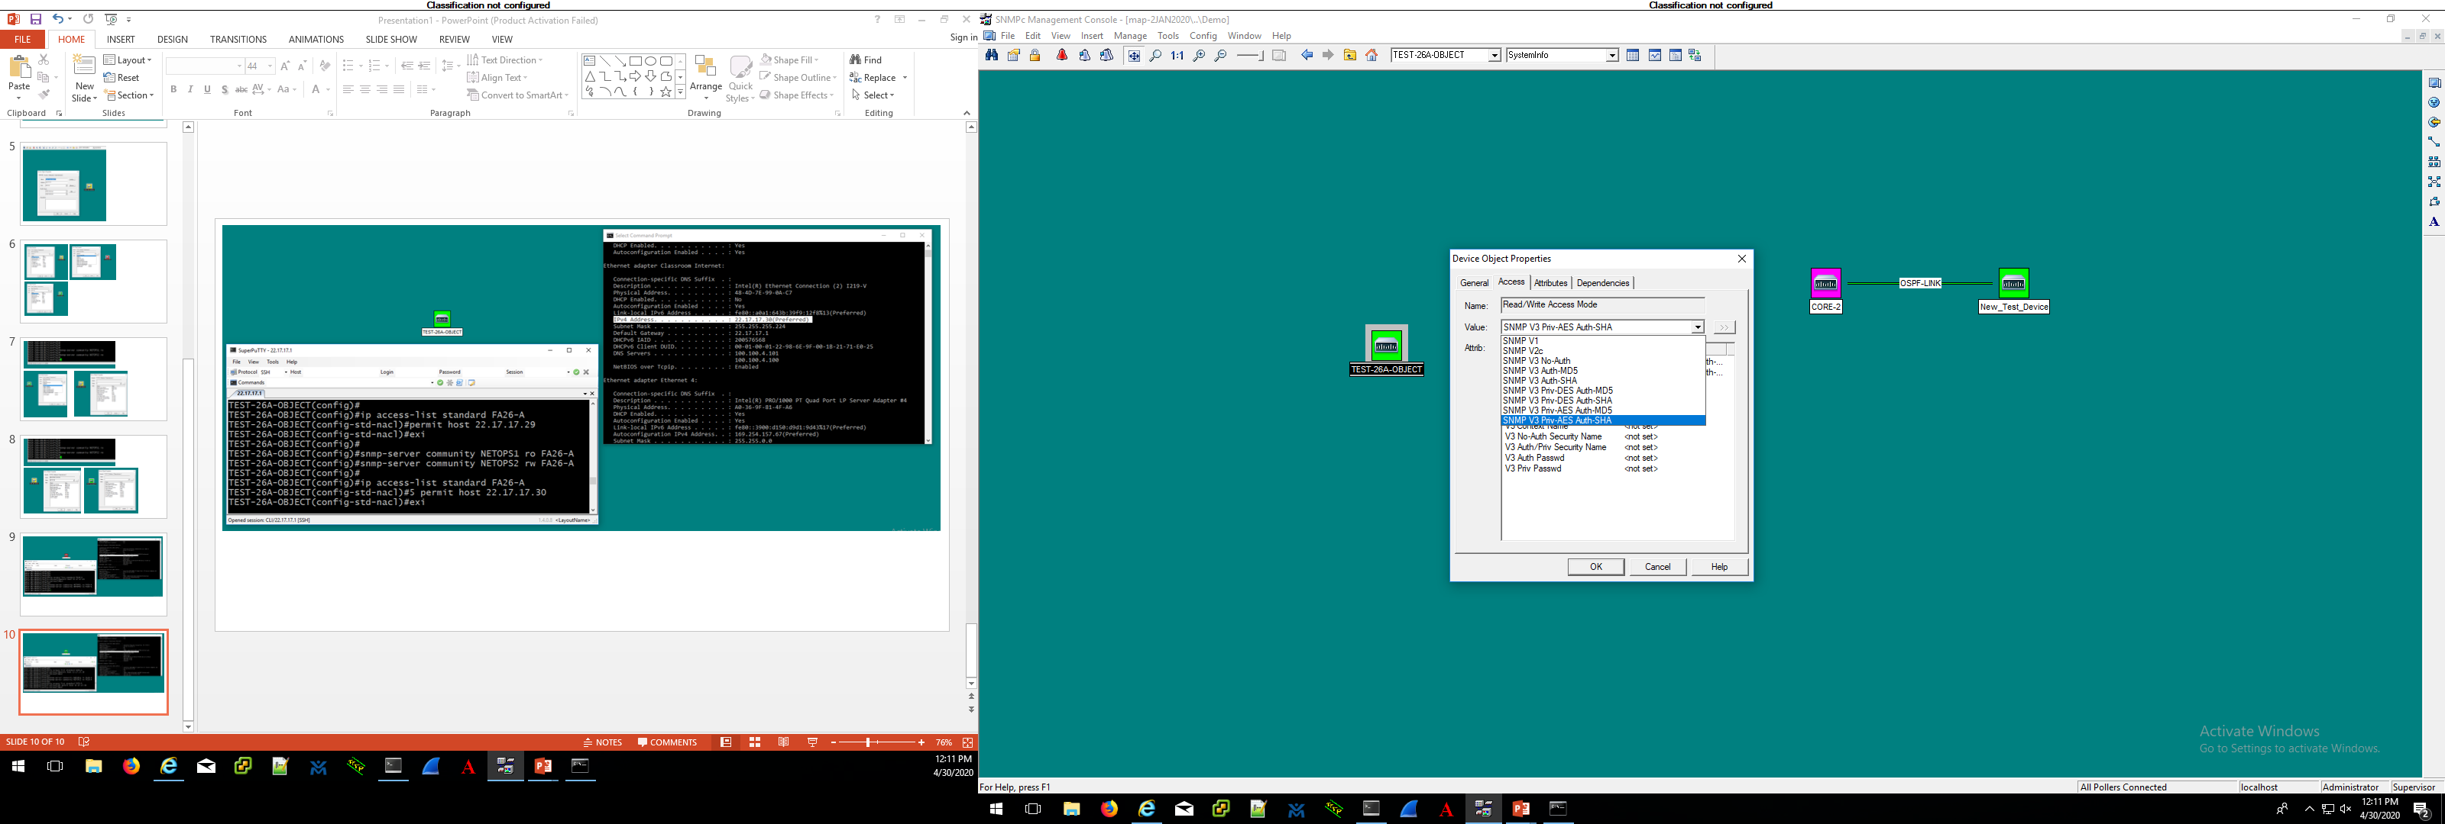
MANAGER
UDP 161
THE PASSWORD IS NETOPS1 SEND ME THE A RESPONSE TO MY POLL FOR INFORMATION
AGENT
“TEST 26-A OBJECT”
THAT IS THE PASSWORD I’M TRACKING AND YOU MATCH THE ACL, SO HERE IS THE INFORMATION
UDP 161
22.17.17.30
22.17.17.1
SNMPv2 agent running configuration:
snmp-server community NETOPS1 ro FA-26A
snmp-server community NETOPS2 rw FA-26A
Ip access-list standard FA-26A
Permit host 22.17.17.29

Slide 21
MANAGER
AGENT
“TEST 26-A OBJECT”
HEY MANAGER, ONE OF MY INTERFACES JUST WENT DOWN AND I’M SUPPOSED TO SEND YOU TRAPS. - AGENT
22.17.17.30
UDP 162
“TRAPS” AND “INFORMS” ARE
TYPICALLY SENT USING UDP PORT 162

Slide 22
MANAGER
SNMPv3
AGENT
If an icon on the SNMP manager is set to poll for SNMPv3, it needs basic reachability along with credentials listed on the access tab of the icon that also specify what (if any) mechanisms are used for authentication and encryption. MD5 and SHA are hash algorithms used for authentication and AES and DES are typically used for encryption.
There are 3 levels of security that can be implemented with SNMPv3:
noAuthnoPriv – username only for authentication, no encryption
authNoPriv - MD5 or SHA for authentication, no encryption
authPriv – MD5 or SHA for authentication and AES/DES for encryption
In SMNPv3 configs authentication is referred to as “auth” and encryption is referred to as “priv”

Slide 23
ON THE ICON ACCESS TAB, YOU CAN
MODIFY THE MANAGER TO CHECK
FOR SNMPv3 BY CHANGING THE
READ OR READ/WRITE ACCESS
OPTIONS ON THE DROP-DOWN MENU

Slide 24
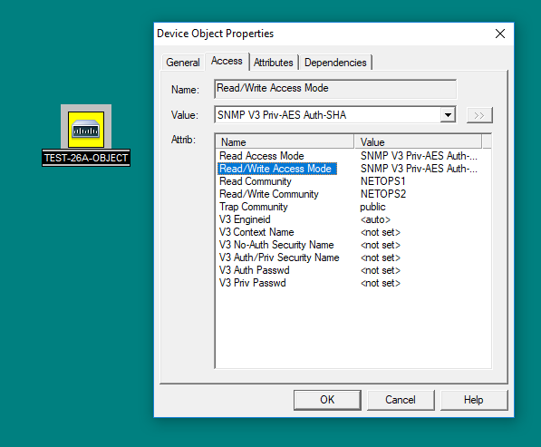
THE ICON IS NOW SET
TO CHECK FOR SNMPv3
BUT THE SNMPv3 CREDENTIALS
ARE NOT POPULATED AND THE
POLL FAILS, TURNING THE ICON
YELLOW

Slide 25
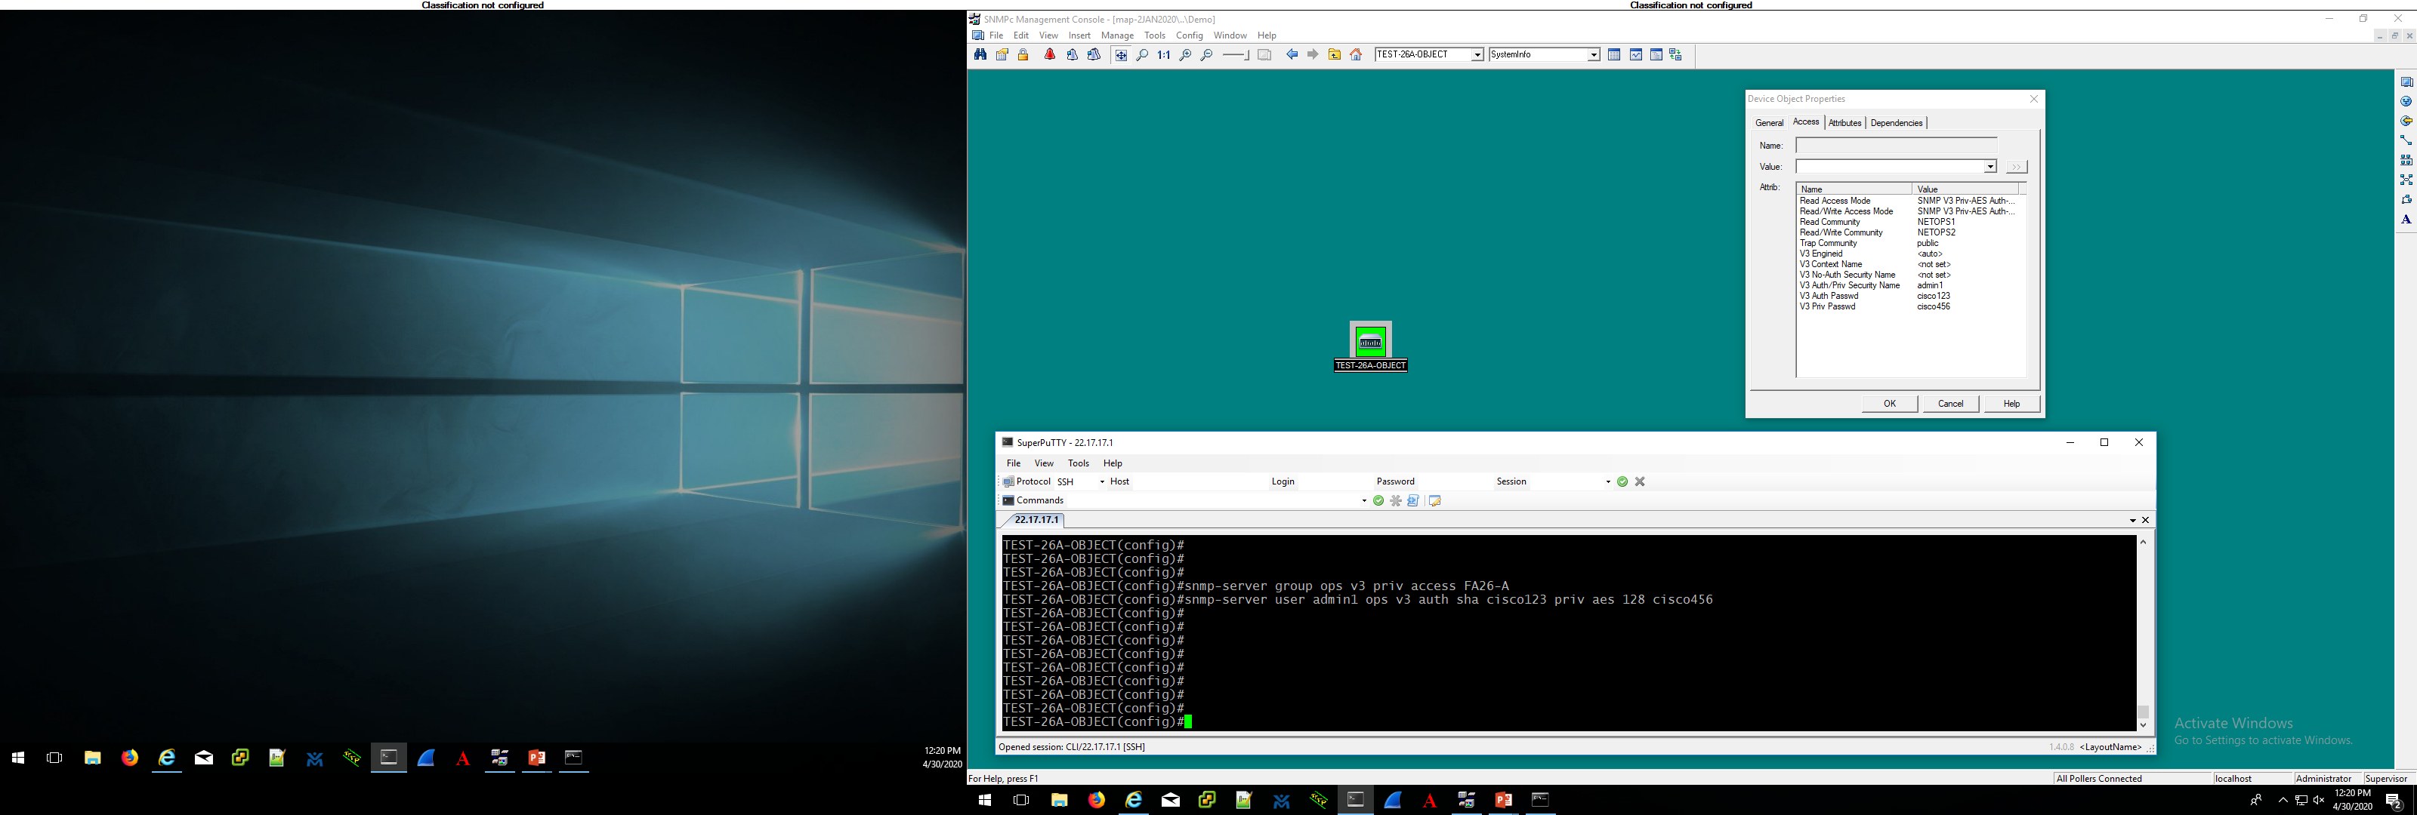
CONFIGURE SNMPv3 CREDENTIALS ON THE
AGENT (ABOVE). IN THIS CASE A GROUP
CALLED “ops” HAS BEEN CREATED AND A
USER “admin1” HAS BEEN ASSIGNED. THE
AUTH MODE SPECIFIED IS SHA WITH A
PASSWORD OF cisco123 AND THE PRIV
MODE IS SET TO AES 128 WITH A PASSWORD
OF cisco456.
MATCHING CREDENTIALS ARE POPULATED ON THE SNMP ICON WHICH ALLOWS THE SNMP POLL TO BE SUCCESSFUL AND THE
ICON TURNS GREEN AGAIN

Slide 26
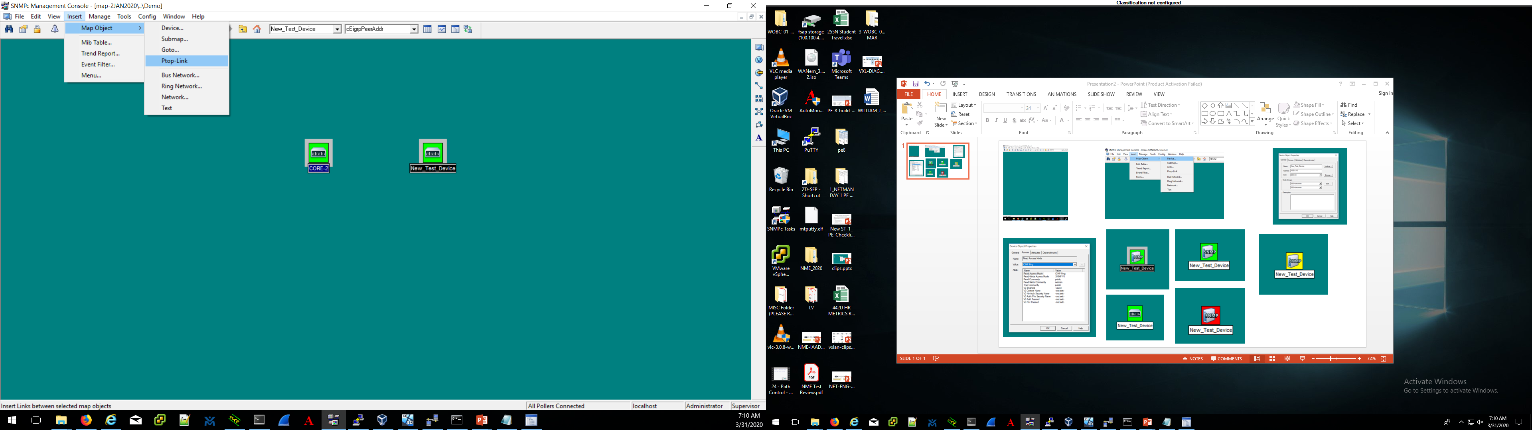
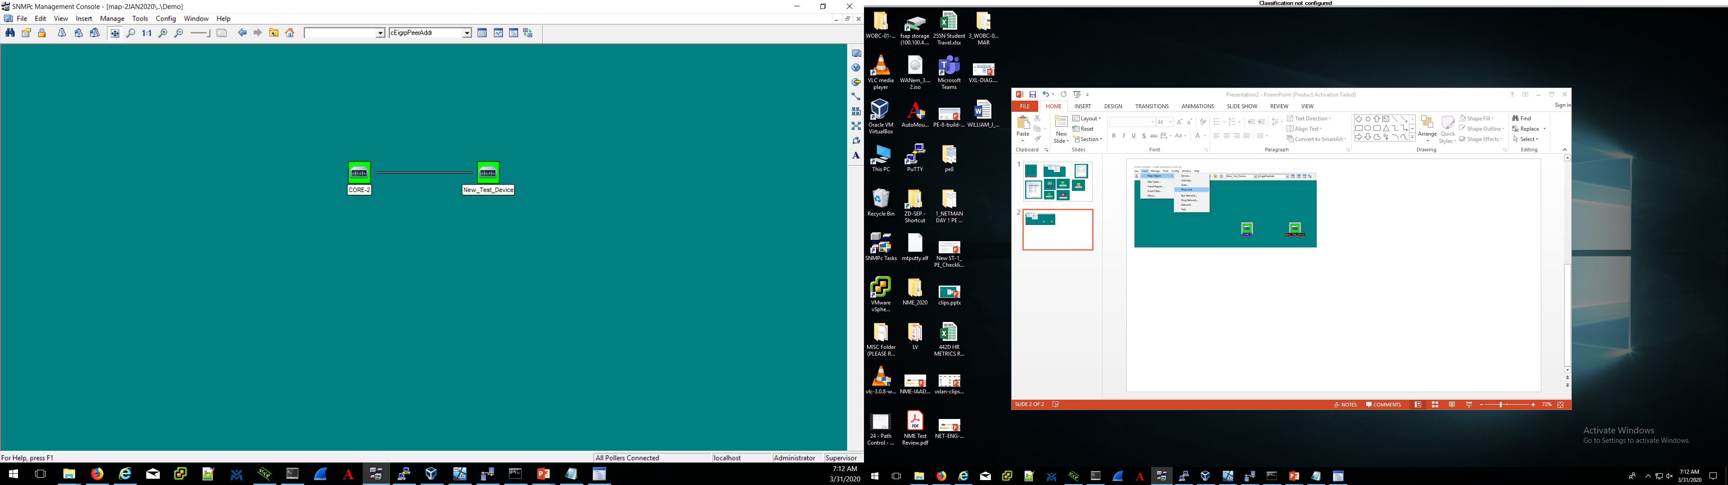
You can create icons that represent links between your device icons. They can be used as visual aids on your map to show user-defined connections or they can be assigned IP addresses and SNMP characteristics that will depict statuses. To create a point to point link highlight two icons by holding the control key and clicking on them. Then click insert > map object > Ptop-Link
When first created, the link is just
a grey line that shows a connection
between the two icons, based on
where the administrator has
placed it. It is not actually deriving
any SNMP information about a real
link at this point.

Slide 27
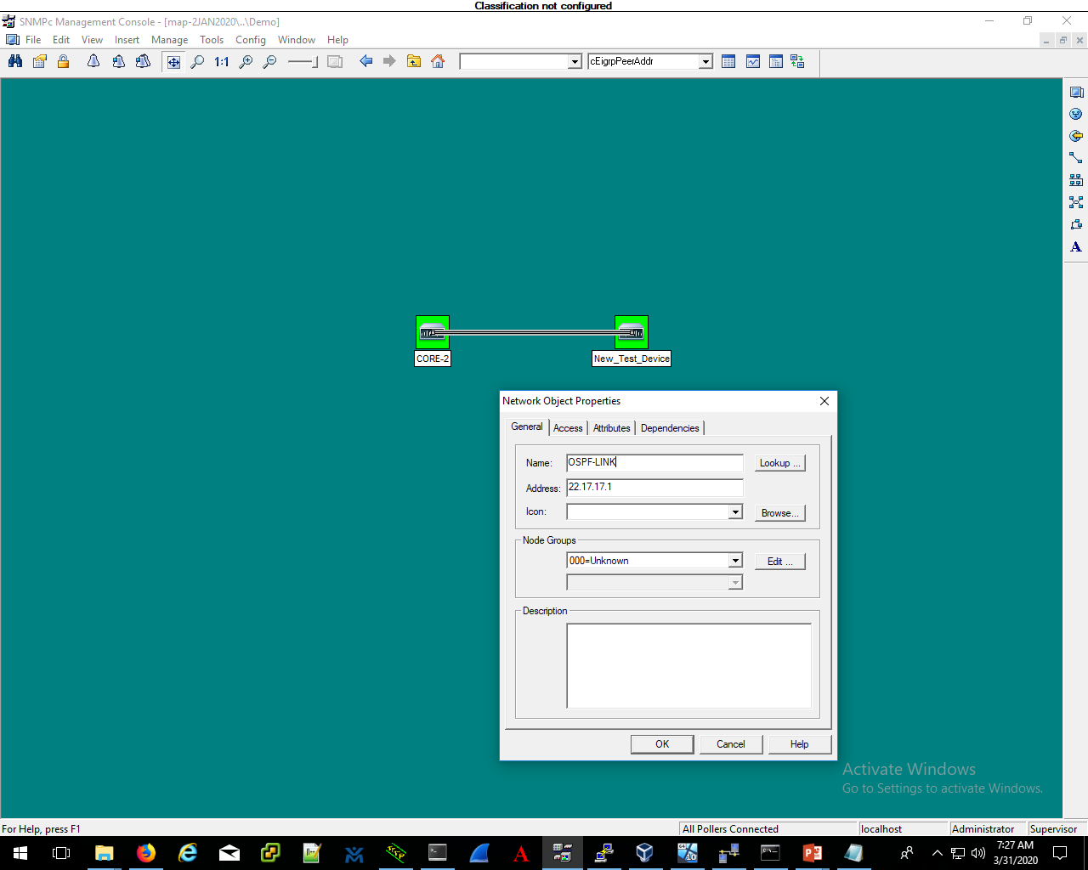
To modify the link, right click it and select properties. You can name the link (such as OSPF-LINK in this case) and assign an IP address that your SNMPc server will poll for information.
If you’re going to use it to indicate a
status you will need to set it up from ICMP or
SNMP on the access tab, just like a standard icon.

Slide 28
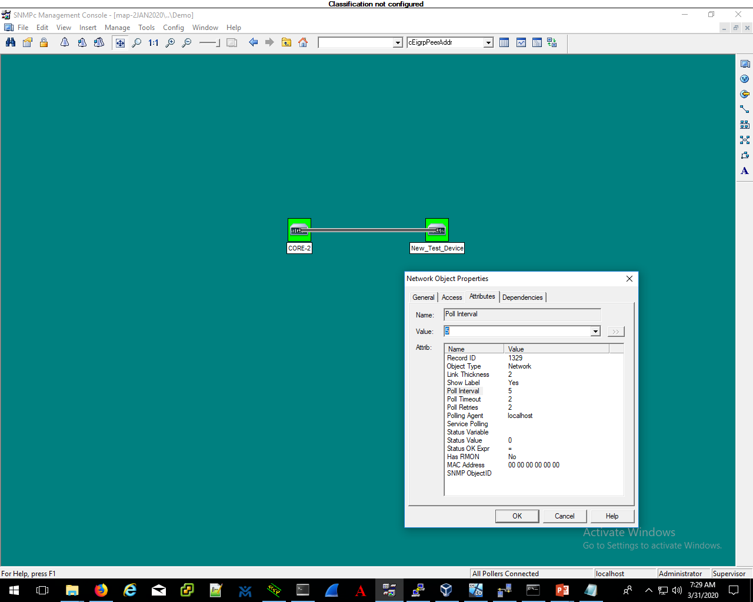
After naming the link and assigning an IP address, go to the attributes tab and change the poll interval from 0 to something like 5, 10 or 30.
This is the amount of time SNMPc will wait to see if it is operational between polls.
NOTE: You can also
change the “show label”
field from No to Yes if
you want to see the name
of the link as text on the
Icon.

Slide 29
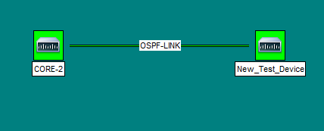
If the link is set for ICMP or SNMP and it is operational, the link will turn green.

Slide 30
MANAGER
AGENT
R2
MIBs (management information base) allow the SNMP manager to request very specific types of information from the agent.
A manager might want to know the status of an OSPF neighbor adjacency between two devices. They can create an icon that references the IP address of the agent as the device that will provide the status of the OSPF neighbor state. This is NOT the IP address of the agent’s OSPF neighbor. The IP address listed in the first tab of the SNMP icon represents the source of the information that the manager wants.
The manager must have the right SNMP credentials and access to extract information from the agent in order for this to work (SNMPv2 or SNMPv3 rights, as well as permitted traffic).
By right-clicking the agent’s icon, you can click on a menu option called tools and then MIB browser which allows you to search for MIB codes to use within your SNMP platform.

Slide 31
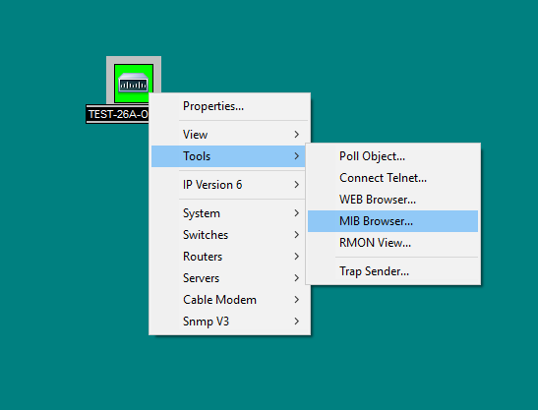
When you right-click on an SNMPc icon, you can get to the MIB browser by selecting TOOLS > MIB BROWSER.

Slide 32
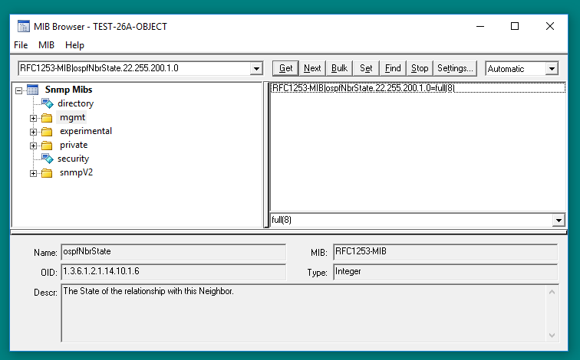
When you right-click on an SNMPc icon, you can get to the MIB browser by selecting TOOLS > MIB BROWSER.
These are the top-level categories of the trees you can expand within the MIB browser. The OSPF neighbor state could be found under:
Mgmt > ospf > ospf neighbor table > ospf neighbor state
*some MIBs options are abbreviated*
The OID (orange arrow) is the actual code broken down into decimal positions based on its sub-categories. The MIB name (blue arrow) is a representation of that code that is easier for administrators to understand.

Slide 33
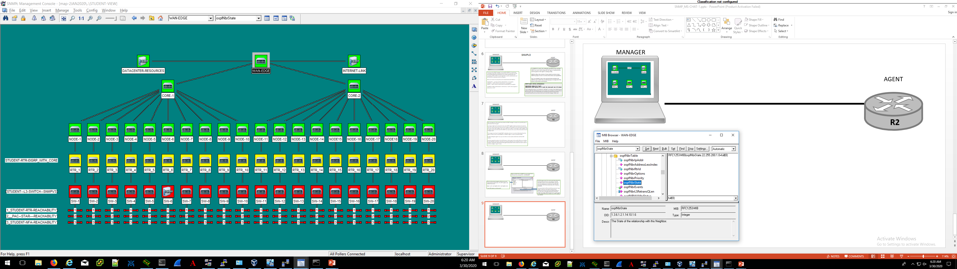
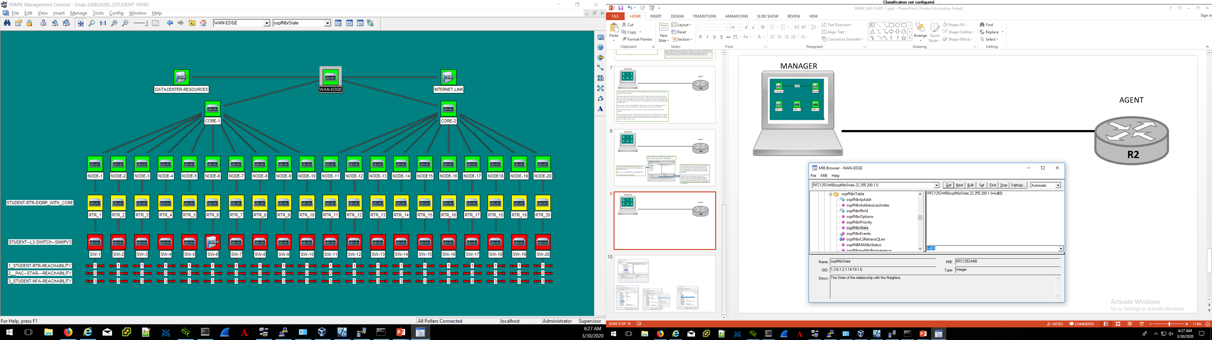
Once you have highlighted the MIB you want (ospfNbrState)
click on “get”.
NOTE: You must have SNMP credentials established to extract
information this way. It will not work with just ICMP.
Use the menu-tree to find the MIB you want. In this case we want an to check for an OSPF neighbor, so go to Mgmt > ospf > ospfNbrTable > ospfNbrState

Slide 34
THE PASSWORD IS NETOPS1 SEND ME THE A RESPONSE TO MY POLL FOR INFORMATION THAT MATCHES THIS MIB CODE
MANAGER
UDP 161
AGENT
“TEST 26-A OBJECT”
YOUR READ-ONLY CREDENTIALS MATCH WAS I HAVE CONFIGURED SO HERE IS THE OSPF INFORMATION YOU REQUESTED WITH THAT MIB
UDP 161
22.17.17.30
22.17.17.1

Slide 35
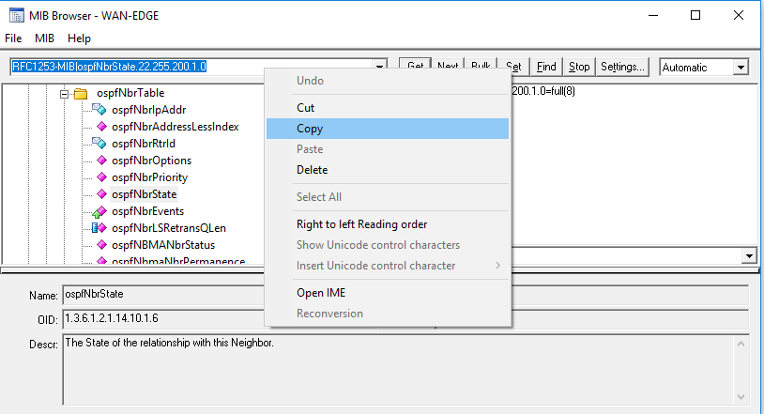
Right click the MIB code displayed to the left of the “Get”button and copy it.
Then exit the MIB Brower on go back to your SNMPc ICON

Slide 36
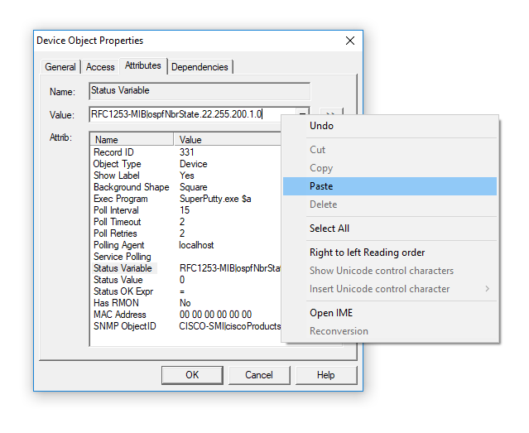
Paste MIB code you just copied from the MIB browser into the Value field.
Go back to your SNMP
Icon and go to the
attributes tab. Highlight
the “status variable”
Option.

Slide 37
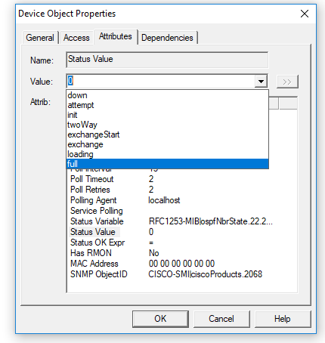
Once a “Status Variable”
has been populated you
will have options in your
“Status Value” field.
Click of the Status Value
Field and select an option
from the drop-down menu.
In this case we see OSPF
neighbor state Options.
Select “full”.

Slide 38

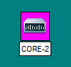
NOTE: Make sure the
poll interval is not set
for 0. For quick feedback
on the status check, set
the poll interval for
5-15 sec.
THE ICON WILL TURN PURPLE
IF THE SNMP INFORMATION
IS BEING DELIVERED TO
THE SNMP MANAGER, BUT
THE AGENT DOES NOT HAVE
THE OSPF NEIGHBOR STATE
THAT THE MIB IS CHECKING FOR
THE ICON WILL TURN GREEN
IF THE SNMP INFORMATION
IS BEING DELIVERED TO
THE SNMP MANAGER, AND
THE AGENT HAS THE OSPF
NEIGHBOR STATE THAT THE MIB
IS CHECKING FOR

Slide 39
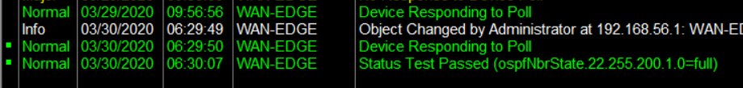
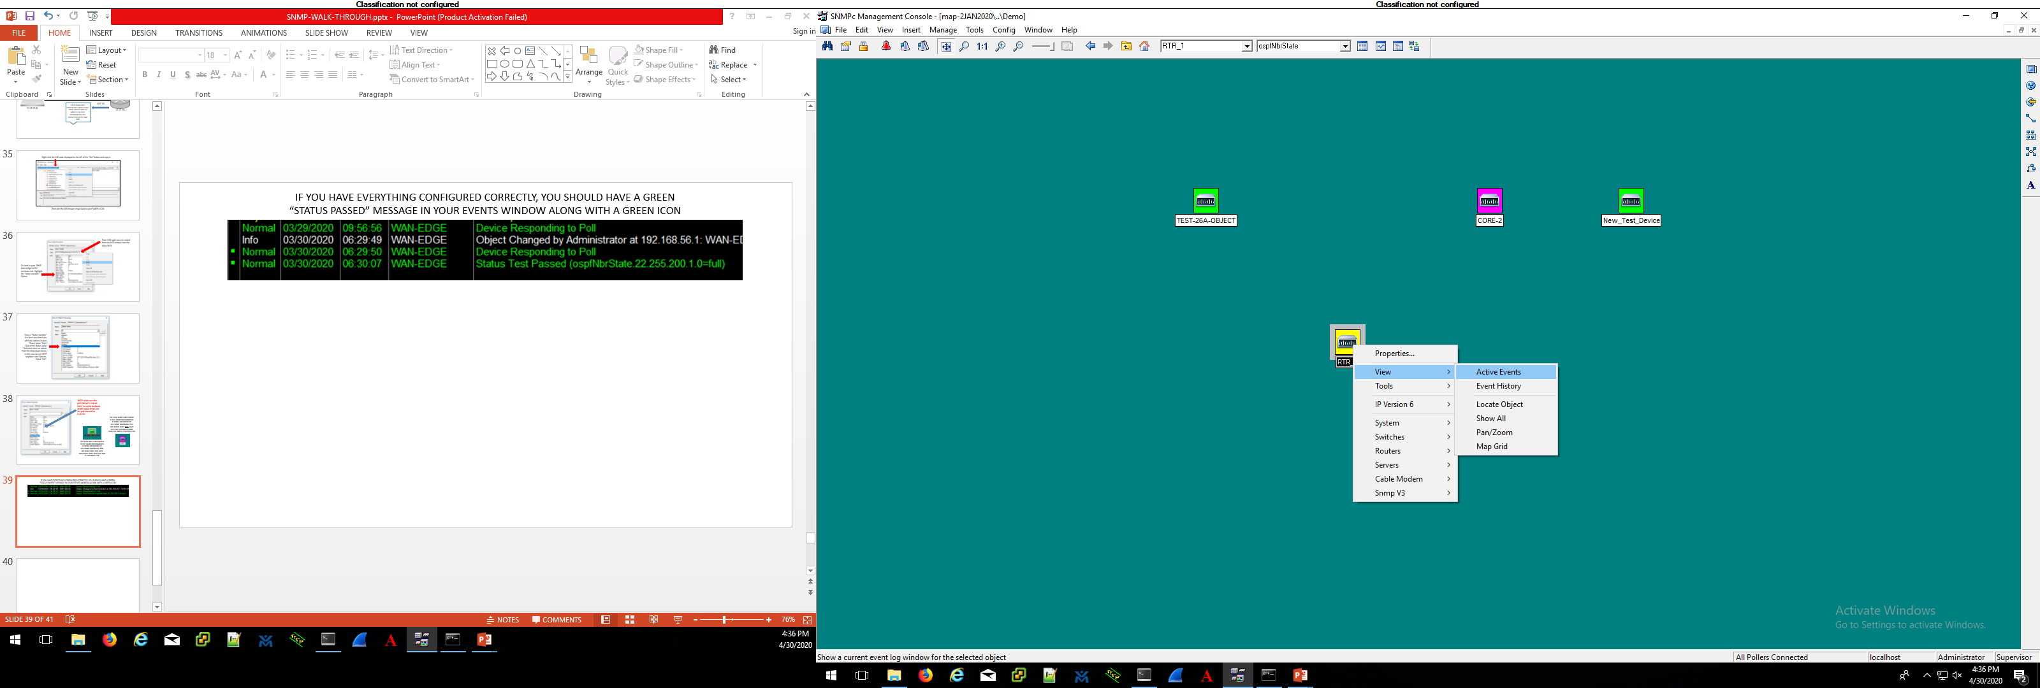
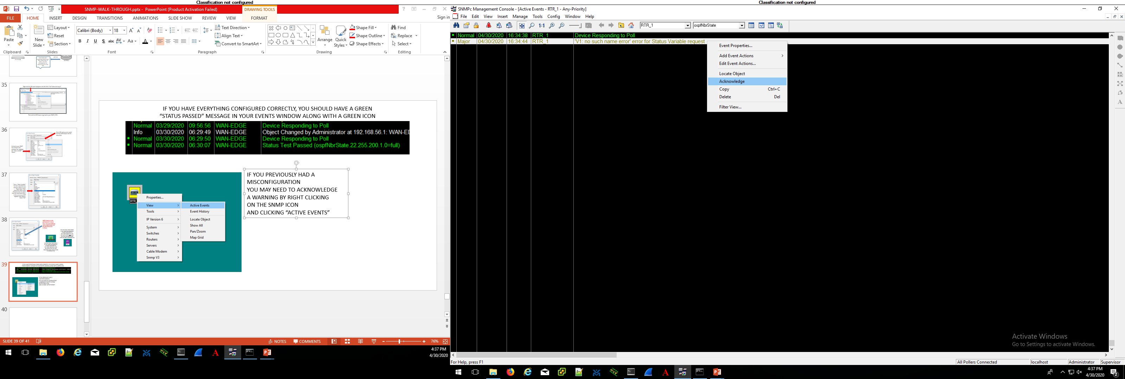
IF YOU HAVE EVERYTHING CONFIGURED CORRECTLY, YOU SHOULD HAVE A GREEN “STATUS PASSED” MESSAGE IN YOUR EVENTS WINDOW ALONG WITH A GREEN ICON
IF YOU PREVIOUSLY HAD A MISCONFIGURATION
YOU MAY NEED TO ACKNOWLEDGE A WARNING
BY RIGHT CLICKING ON THE SNMP ICON
AND CLICKING “ACTIVE EVENTS”
IN THE ACTIVE EVENTS WINDOW, HIGHLIGHT THE YELLOW
WARNING MESSAGE, RIGHT-CLICK AND SELECT “ACKNOWLEDGE”
*IF THE CONFIGURATION STILL HAS AN ERROR THE YELLOW
WARNING WILL RETURN AS SOON AS THE NEXT POLL IS RECEIVED*

Slide 40
QUESTIONS?

